Slide 1

MICROSERVICES ARCHITECTURE

Slide 2
INDEX
Monolithic Architecture
Its applications and limitations
Microservice architecture
Its principles
Difference between Monolithic and Microservice architecture
Advantages over monolithic
Microservice is used for?

Slide 3
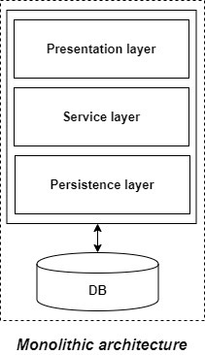
Monolithic Architecture
If all the functionalities of a project exist in a single codebase, then that application is known as a monolithic application

Slide 4
What led us to microservices?
Disadvantages
Reliability
Updates
Technology stack
Difficult to understand
Advantages
Easier to deploy as only a single jar/war file is deployed.
Relatively easier and simple to develop in comparison to microservices architecture.

Slide 5
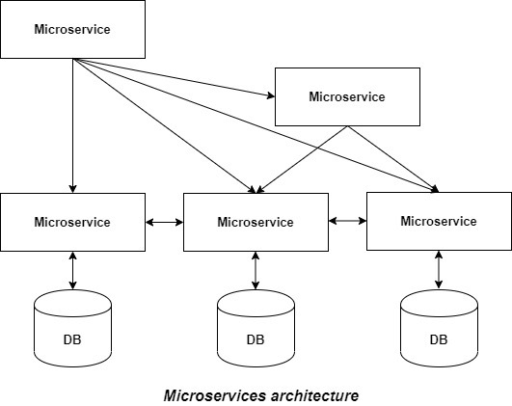
Microservice Architecture
Microservices are an architectural style that develops a single application as a set of small services. Each service runs in its own process. The services communicate with clients, and often each other, using lightweight protocols, often over messaging or HTTP.

Slide 6
Principles of Microservice Architecture
Single Responsibility principle
Modelled around business domain
Isolate Failure
Infrastructure automation
Deploy independently

Slide 7
Monolithic
Microservice
It is built as one large system,
Usually one code-base
It is not easy to scale based on demand.
It is shared database
Large code base makes IDE slow and build time gets increase.
It extremely difficult to change technology or language or framework because everything is tightly coupled and depend on each other
It is built as small independent module based on business functionality
It is easy to scale based on demand
Each project and module has their own database
Each project is independent and small in size. So overall build and development time gets decrease.
Easy to change technology or framework because every module and project is independent

Slide 8
Advantages over Monolithic Architecture
Flexible scaling
Continuous deployment
Highly maintainable and testable
Independently deployable
Technology flexibility
High reliability

Slide 9
What is microservices architecture used for?
Website migration
Media content
Transactions and invoices
Data processing

